Slide 1
Retail Banking System
Pod - 5
Members :
Sangameshwar Melkunde
Sumit Kumar
Ramya Vutukuri
Vaibhav Bhardwaj
Lokesh Lohani
Mentor : Rajendran Thiyagu
Trainer : Pragash Ruddar
Coach : Prema

Slide 2
What are Microservices?
Separating the different functionalities of a application into modules is called a microservice.
In the simplest form, they help build an application as a suite of small services, each running in its own process and are independently deployable.​
Internal operations are a “black box”, accessible to external programs only via API.

Slide 3
Why Microservice?
Each service is independent from one another and can be developed in any language
Can build Robust applications
Microservices communicate with other microservices via Rest Api.
Fault Tolerant Applications can be built .
Each service can have it’s own database. One module can have sql, another one can have mongoDB and so on.

Slide 4
Challenges in Microservice
Testing can be complex.
Requires devops culture.
Large number of microservices places a overhead to keep track of them when the service is down.
Up-front costs may be higher with microservices
Debugging becomes more challenging with microservices.

Slide 5
Project Architecture :
Withdraw
Customer
Login
Transfer
Statement
Create Customer
Create Account
Employee
Login
Display Customer
Service Charge Deduction
Delete Account

Slide 6
Microservices Used
Bank MVC
Authorization
Accounts
Customer
Rules
Transactions

Slide 7
Bank MVC :
This is the front-end of the Web Application. It houses all the JSP pages and redirects the requests to appropriate microservice.
Authorization Microservice :​
​
This service acts as a login authenticator for the application.​
JWT, is used as a authentication protocol for this application. ​

Slide 8
Accounts Microservice :
This microservice handles the activities related to account, like creating account for a customer, deleting an account.
Also, it uses the Rest API’s from authentication microservice to validate the user accessing the resource and transaction, customer microservice.

Slide 9
Customer Microservice :
This microservice provides services such as create customer, update customer, find customer details based on ID and delete customer.
It also uses the Rest API’s from authentication microservice to validate the user accessing the resource and account microservice to create the account for the customer

Slide 10
Rules Microservice :
This microservice checks if the balance in every account is above the minimum value.
It then deducts 10% of current balance as service charge if the above condition is not satisfied.

Slide 11
Transactions Microservice :
This is responsible for performing all the transaction within the bank application like deposit, withdrawal and transfers.
Transaction microservice is also used to deduct the service charges when invoked by account microservice.

Slide 12
Frontend Snapshots

Slide 13
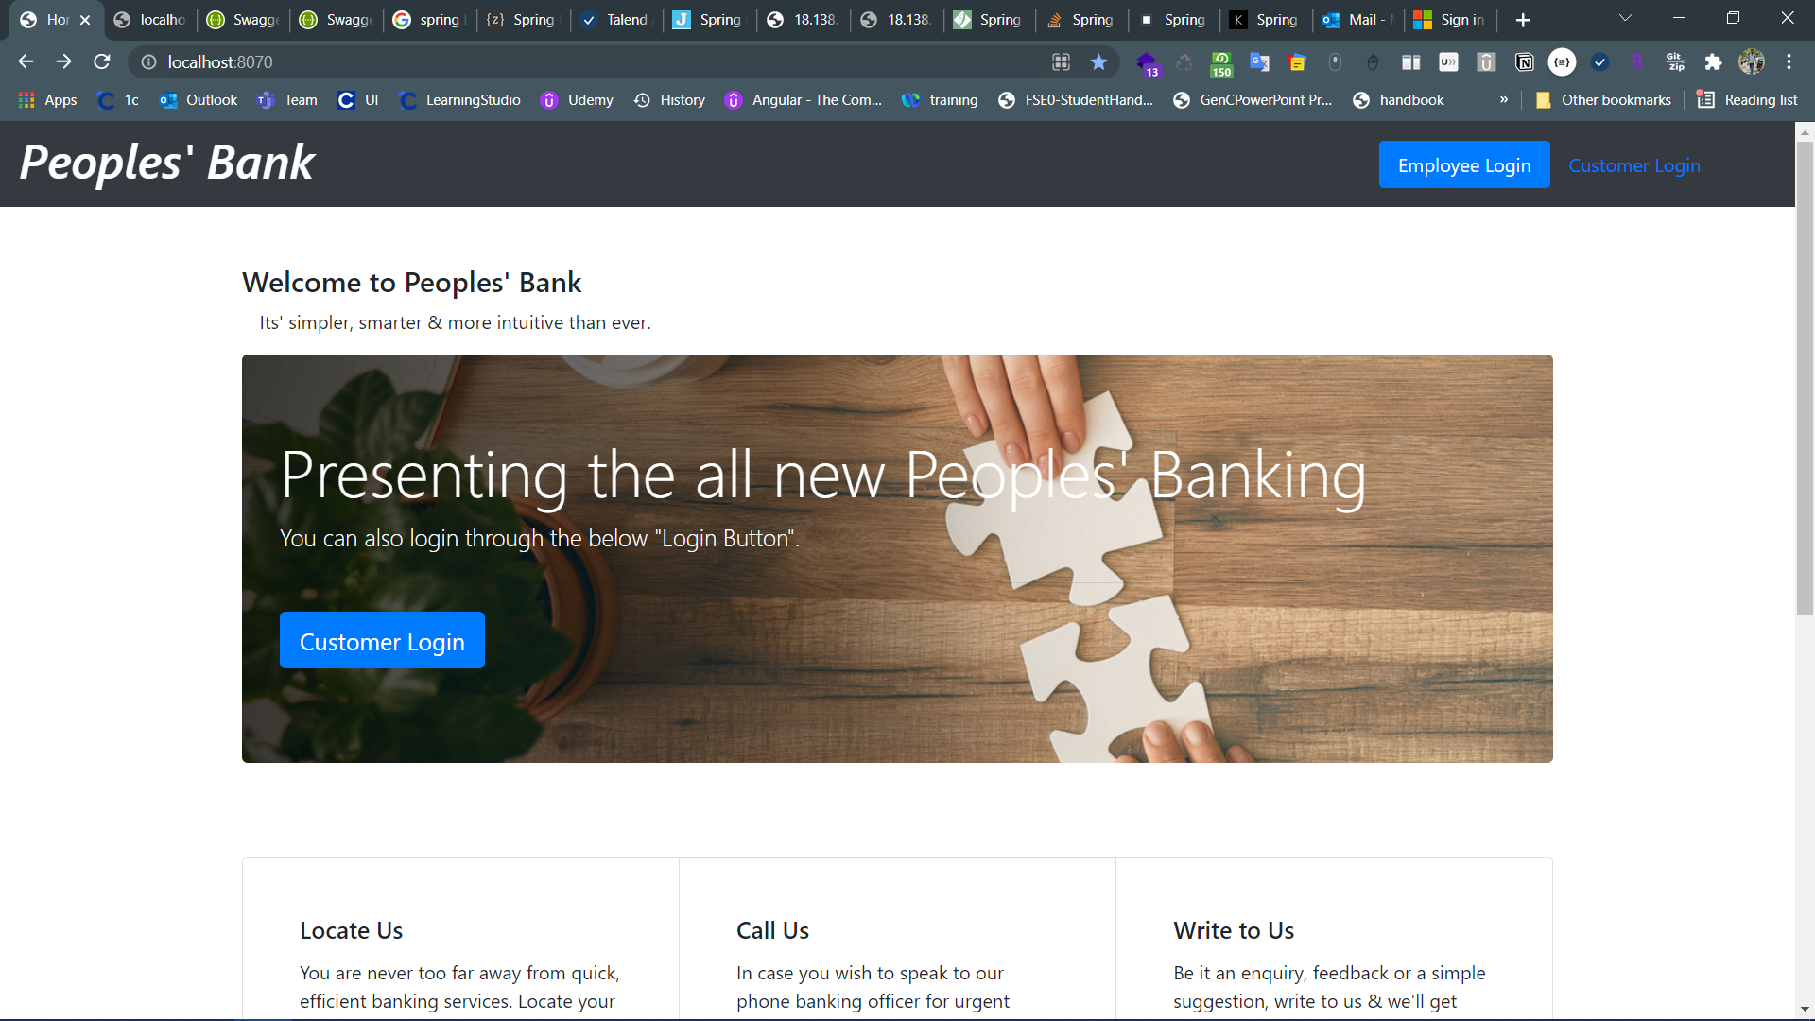

Slide 14
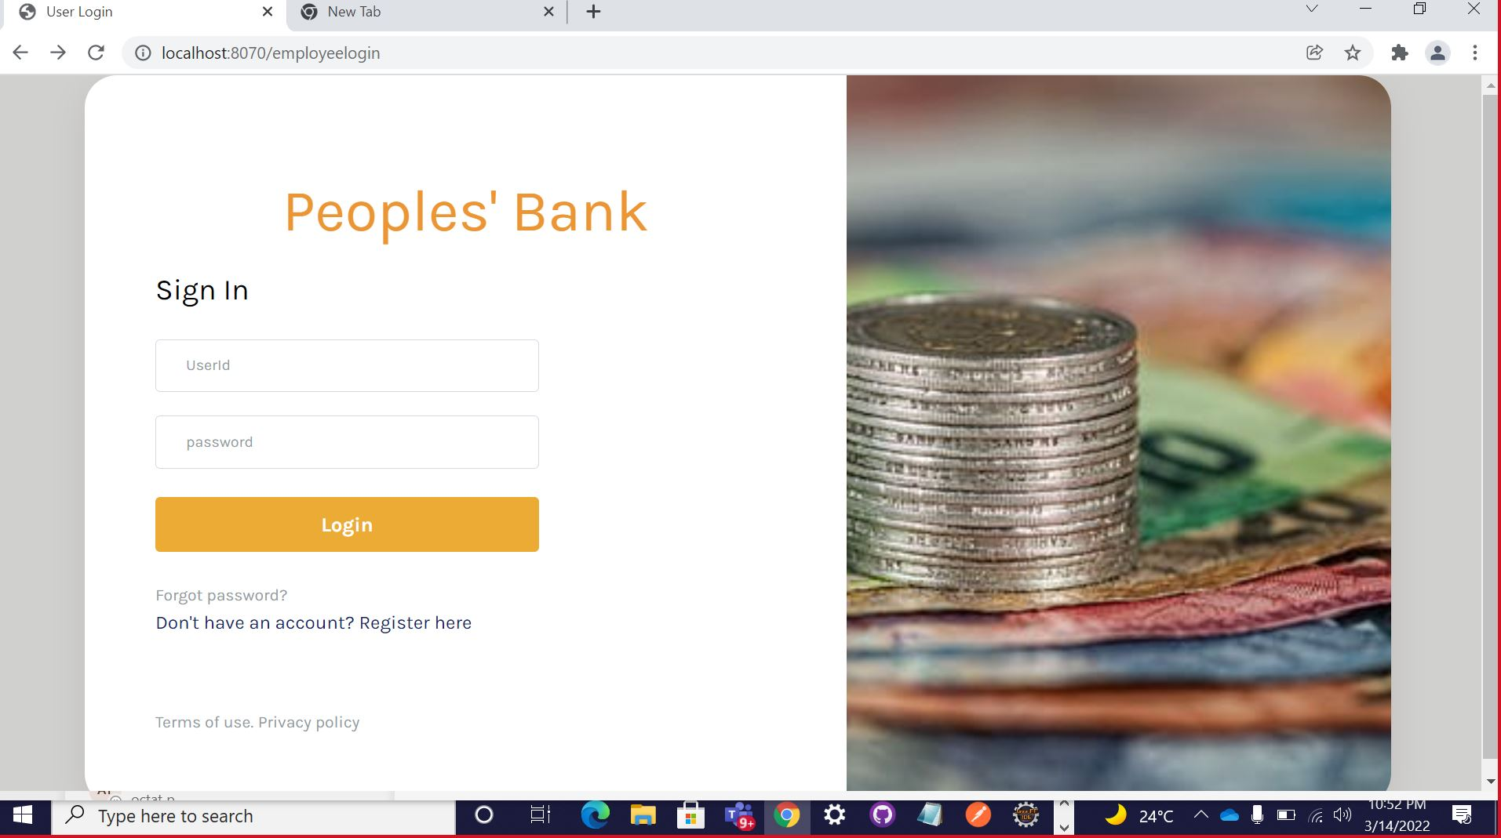

Slide 15
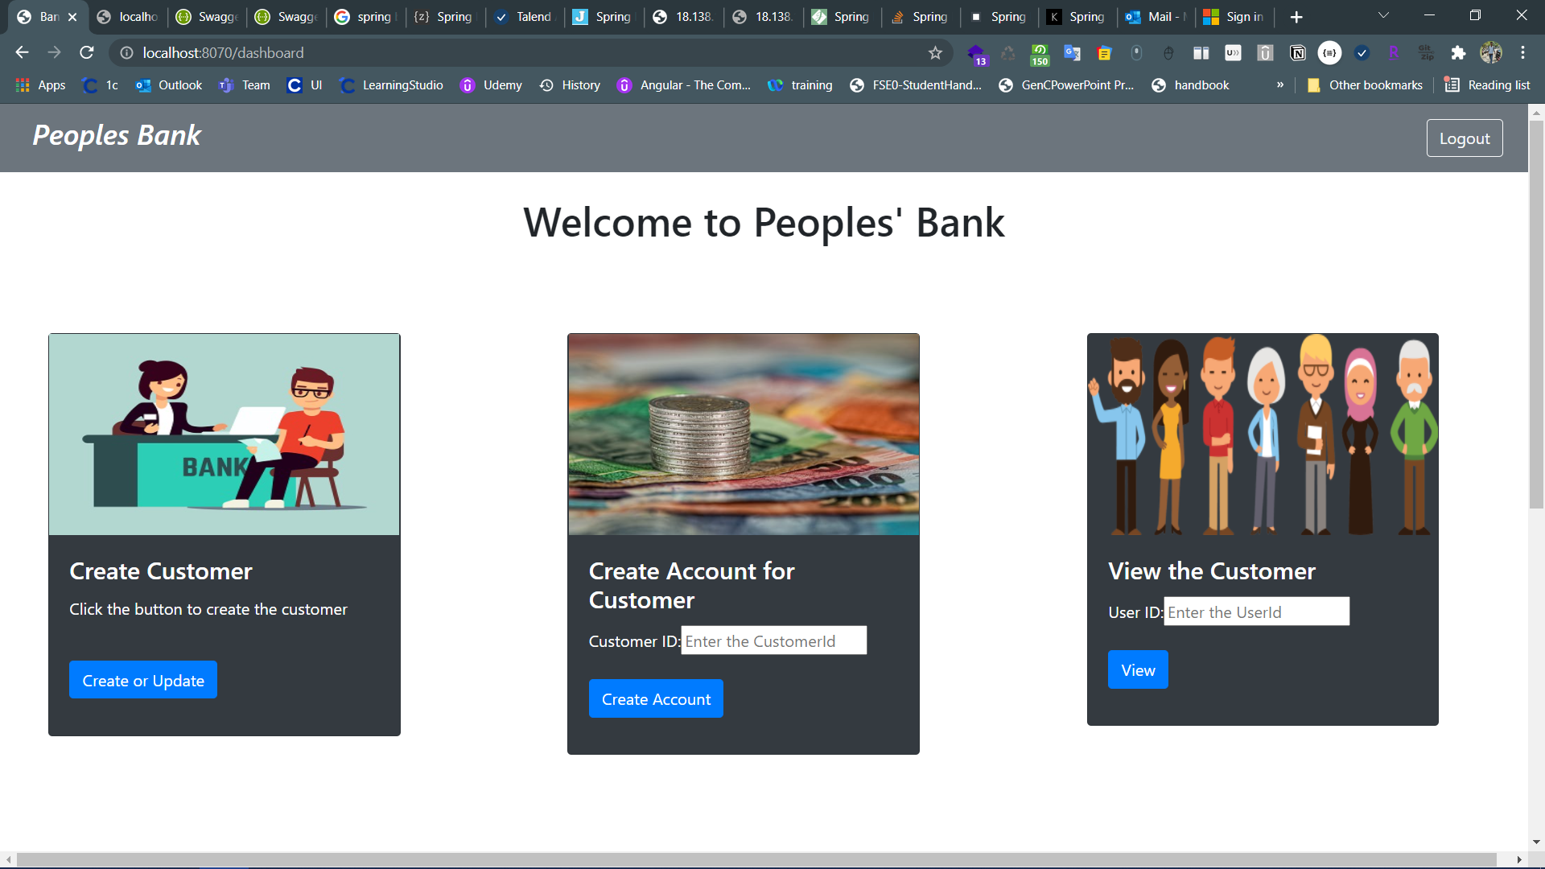

Slide 16
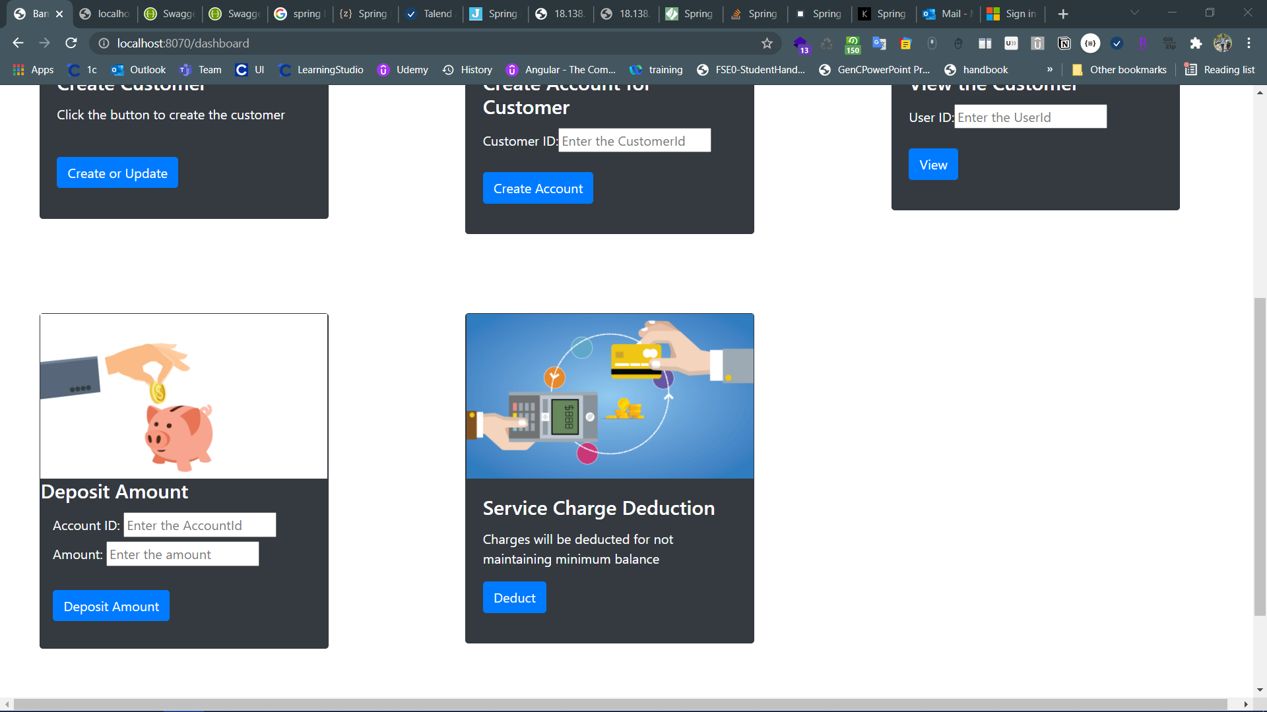

Slide 17
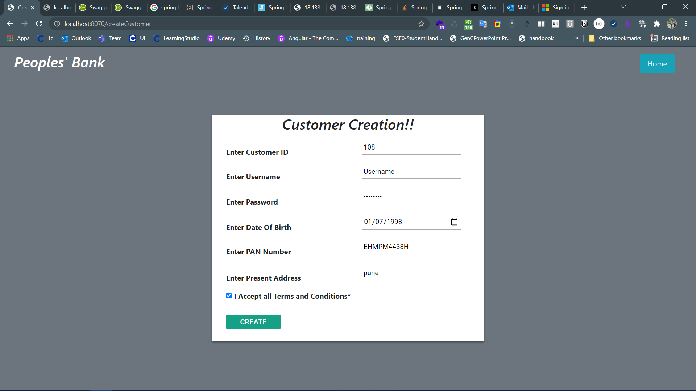

Slide 18


Slide 19
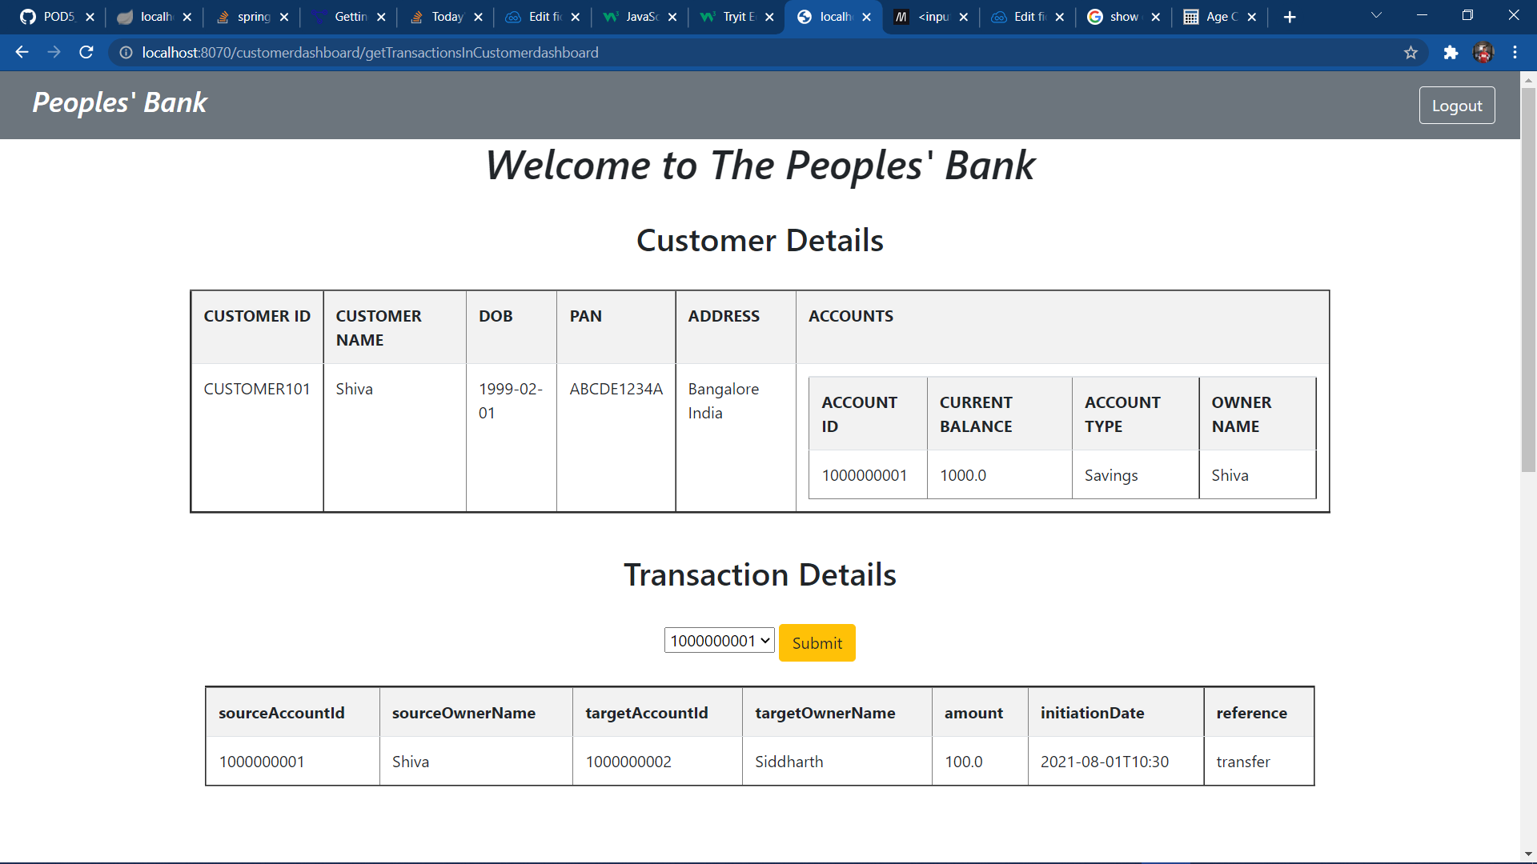

Slide 20
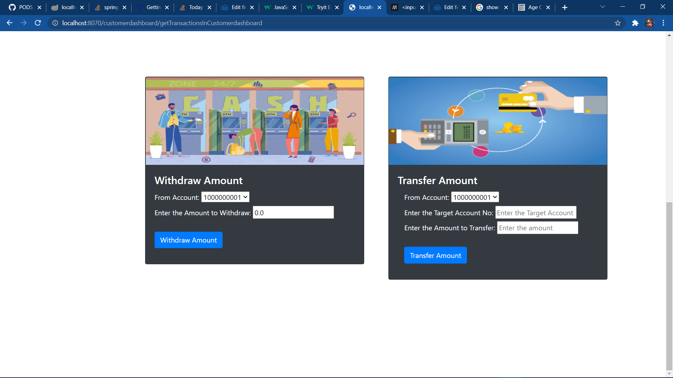

Slide 21
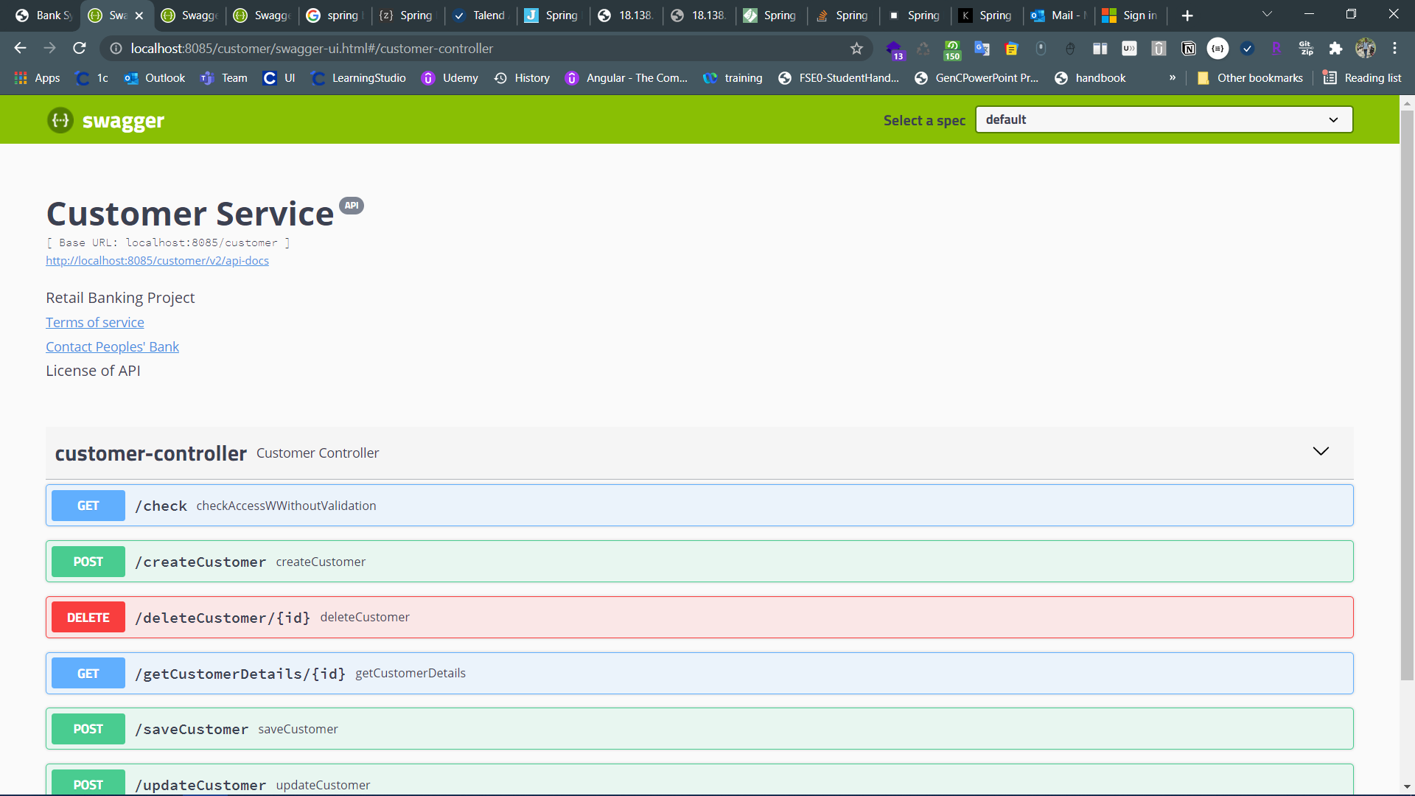

Slide 22
AWS Snapshots

Slide 23
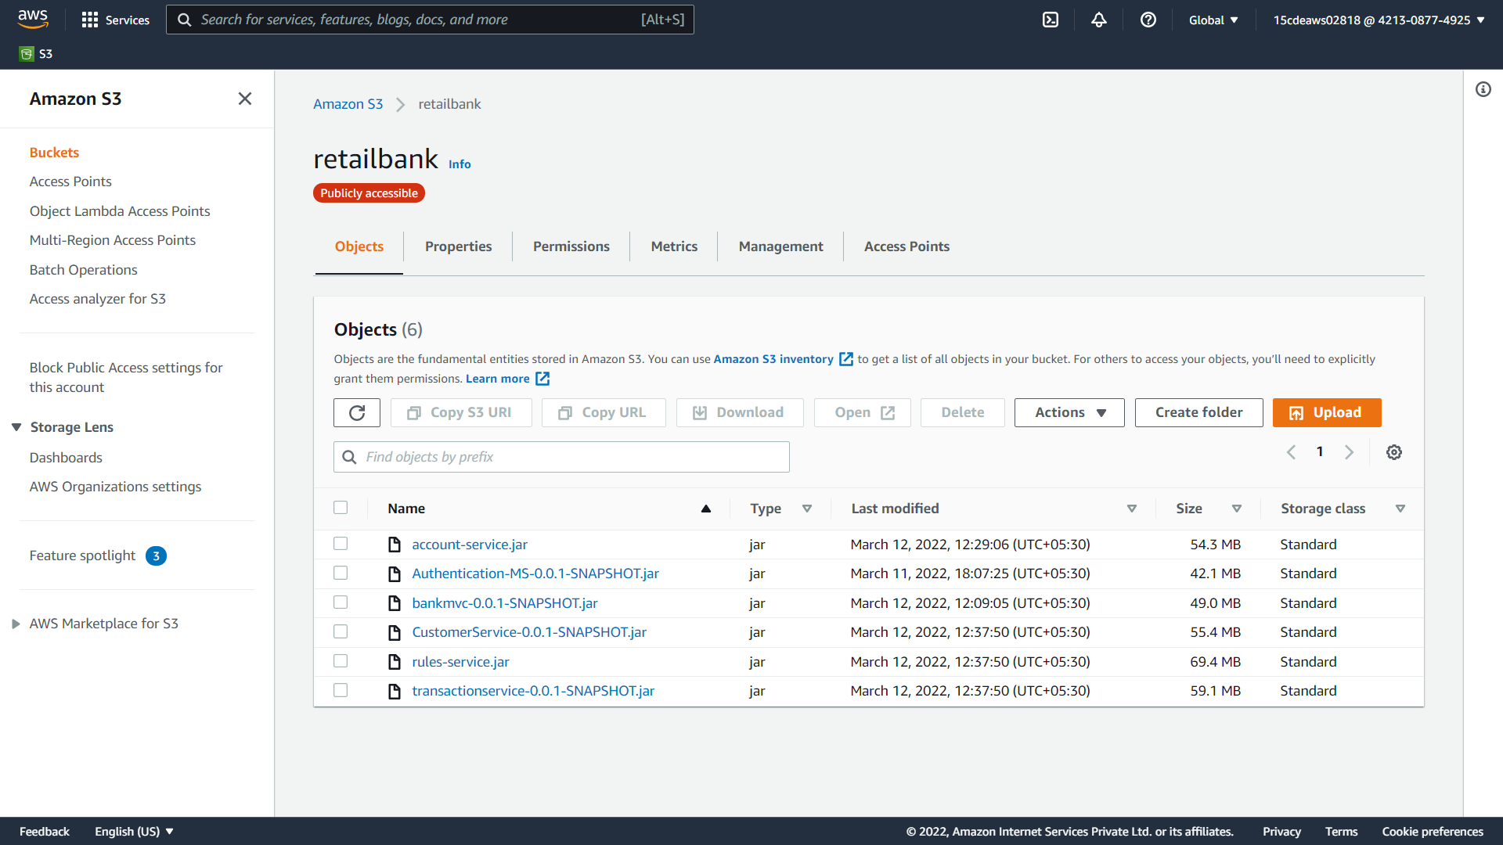

Slide 24
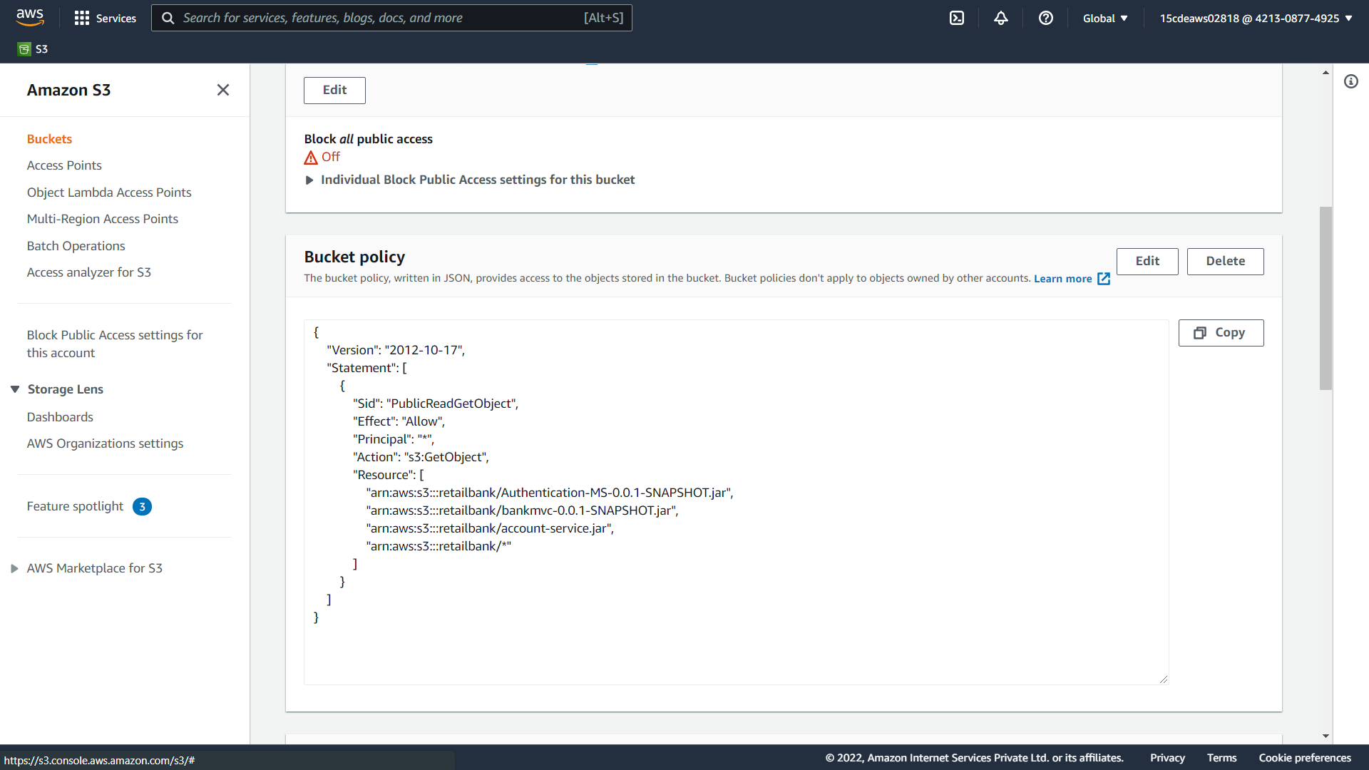

Slide 25
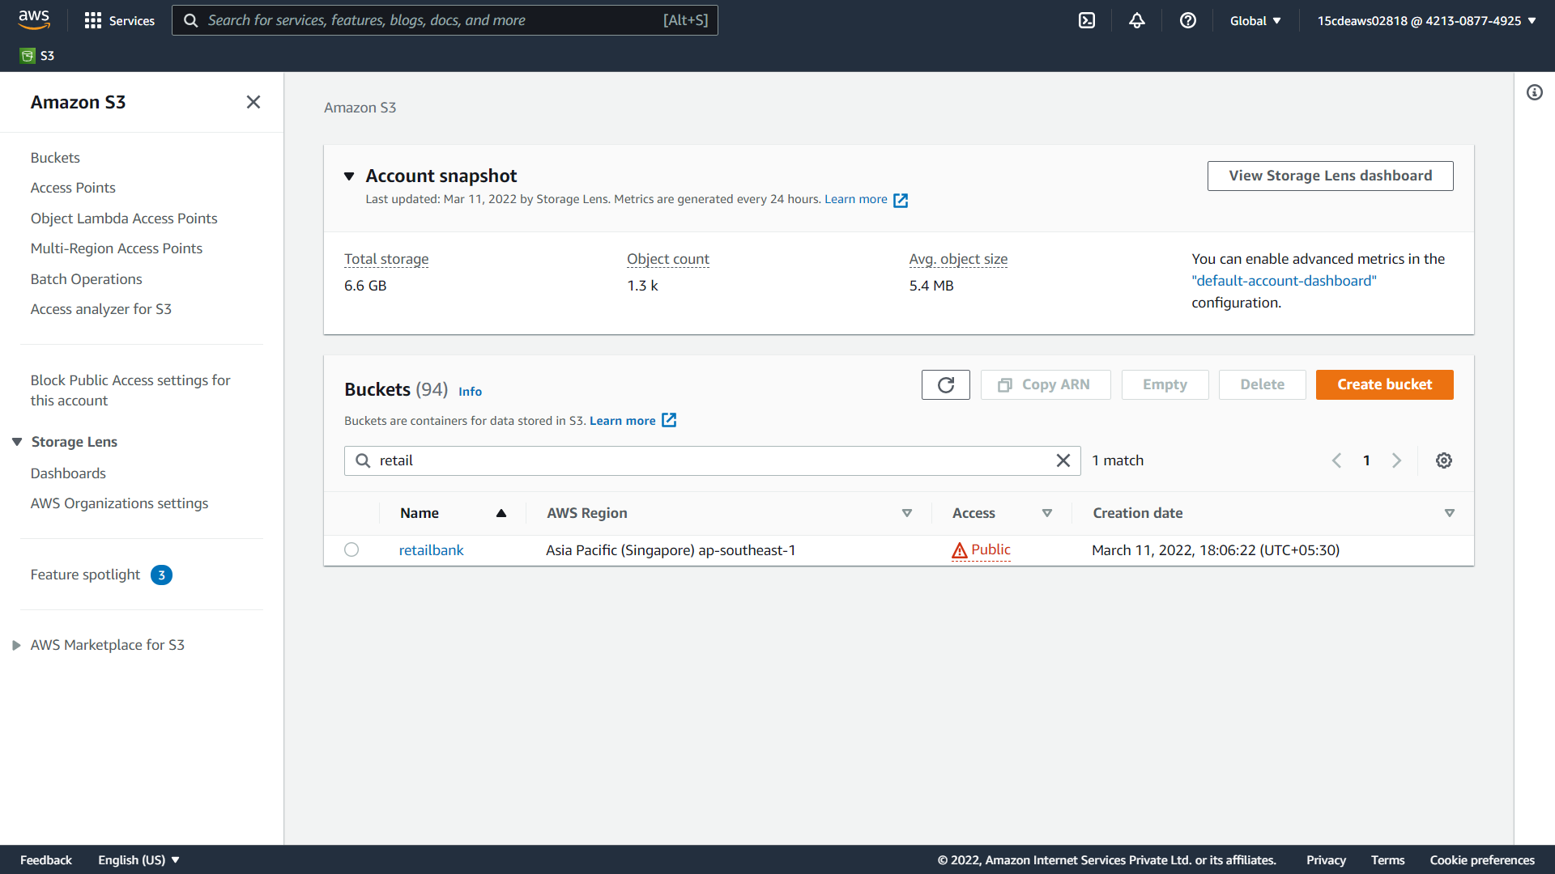

Slide 26
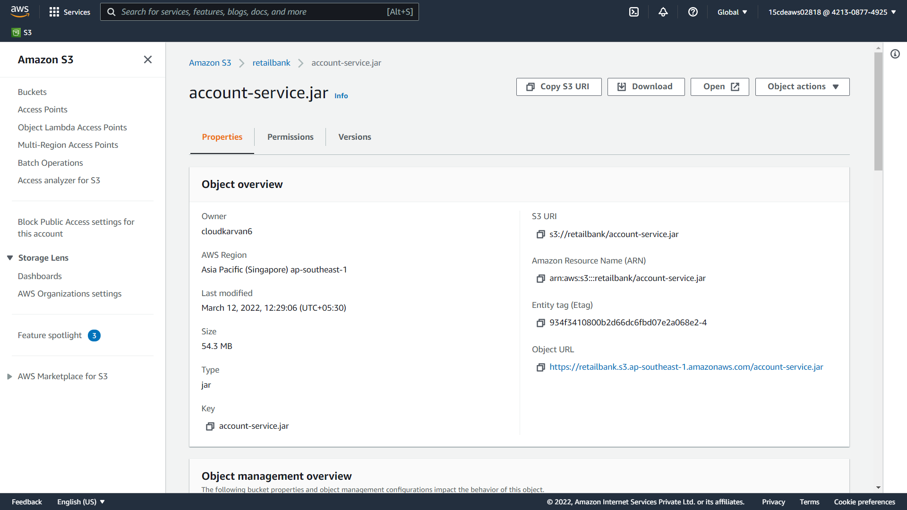

Slide 27
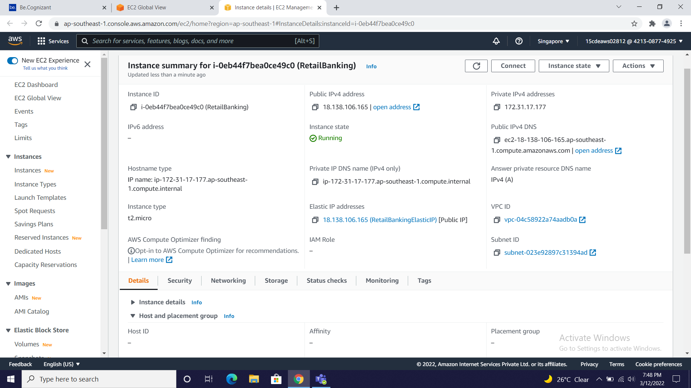

Slide 28
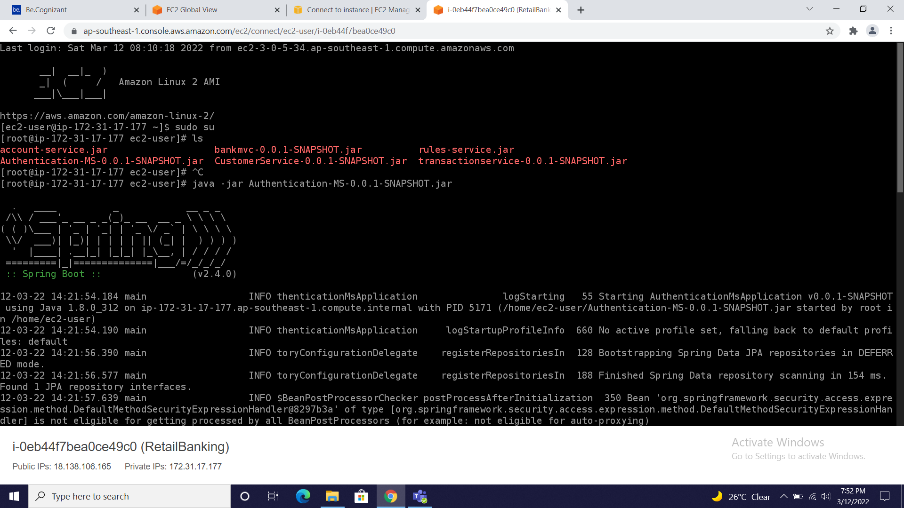
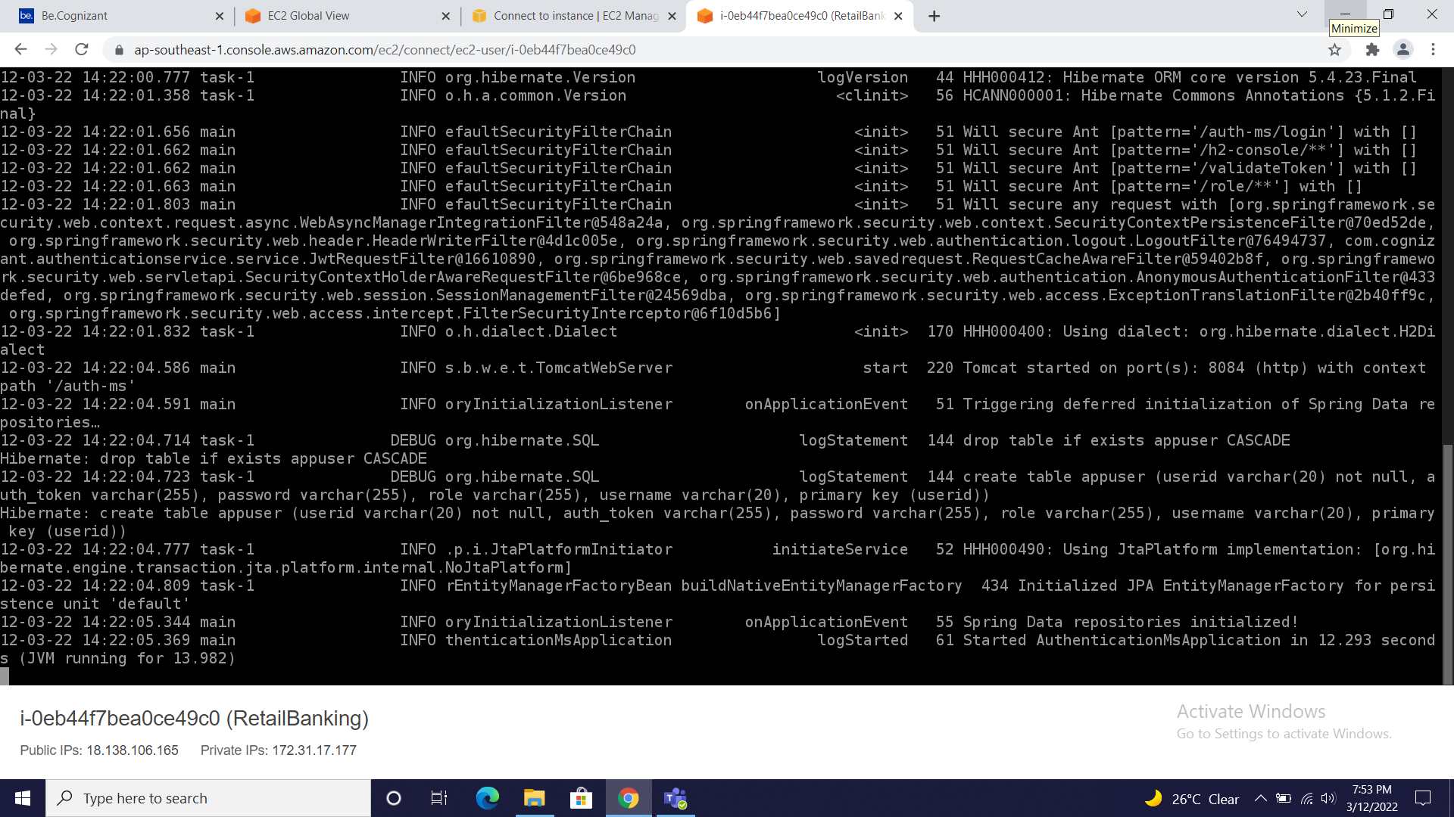
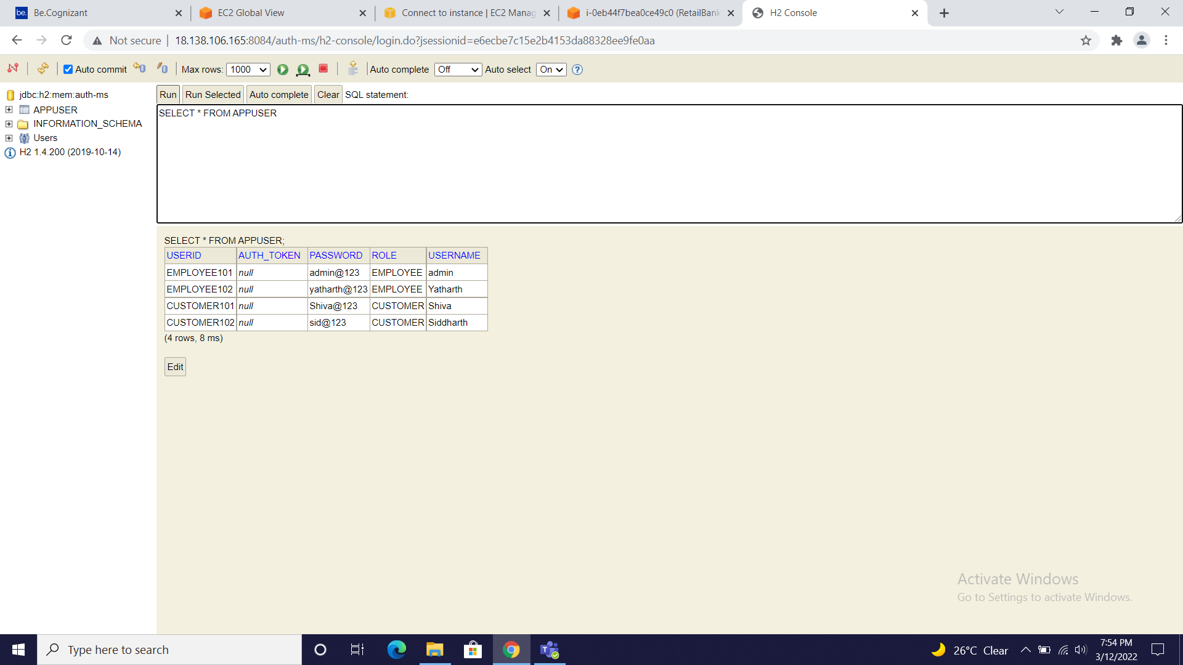

Slide 29
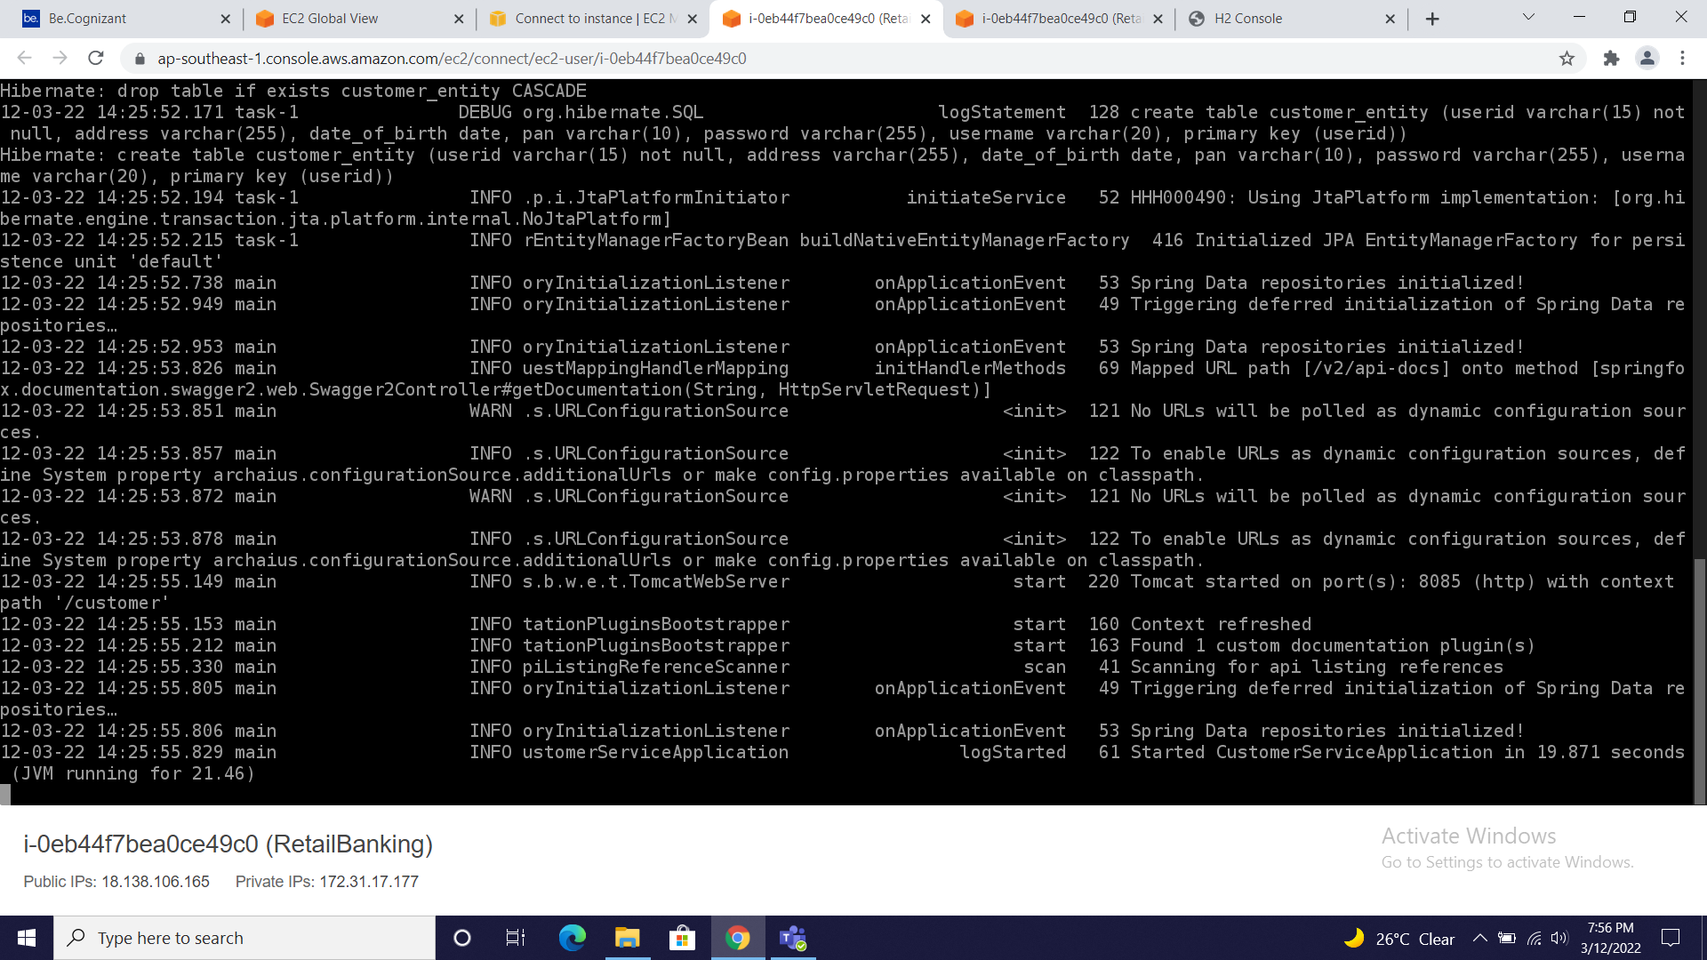

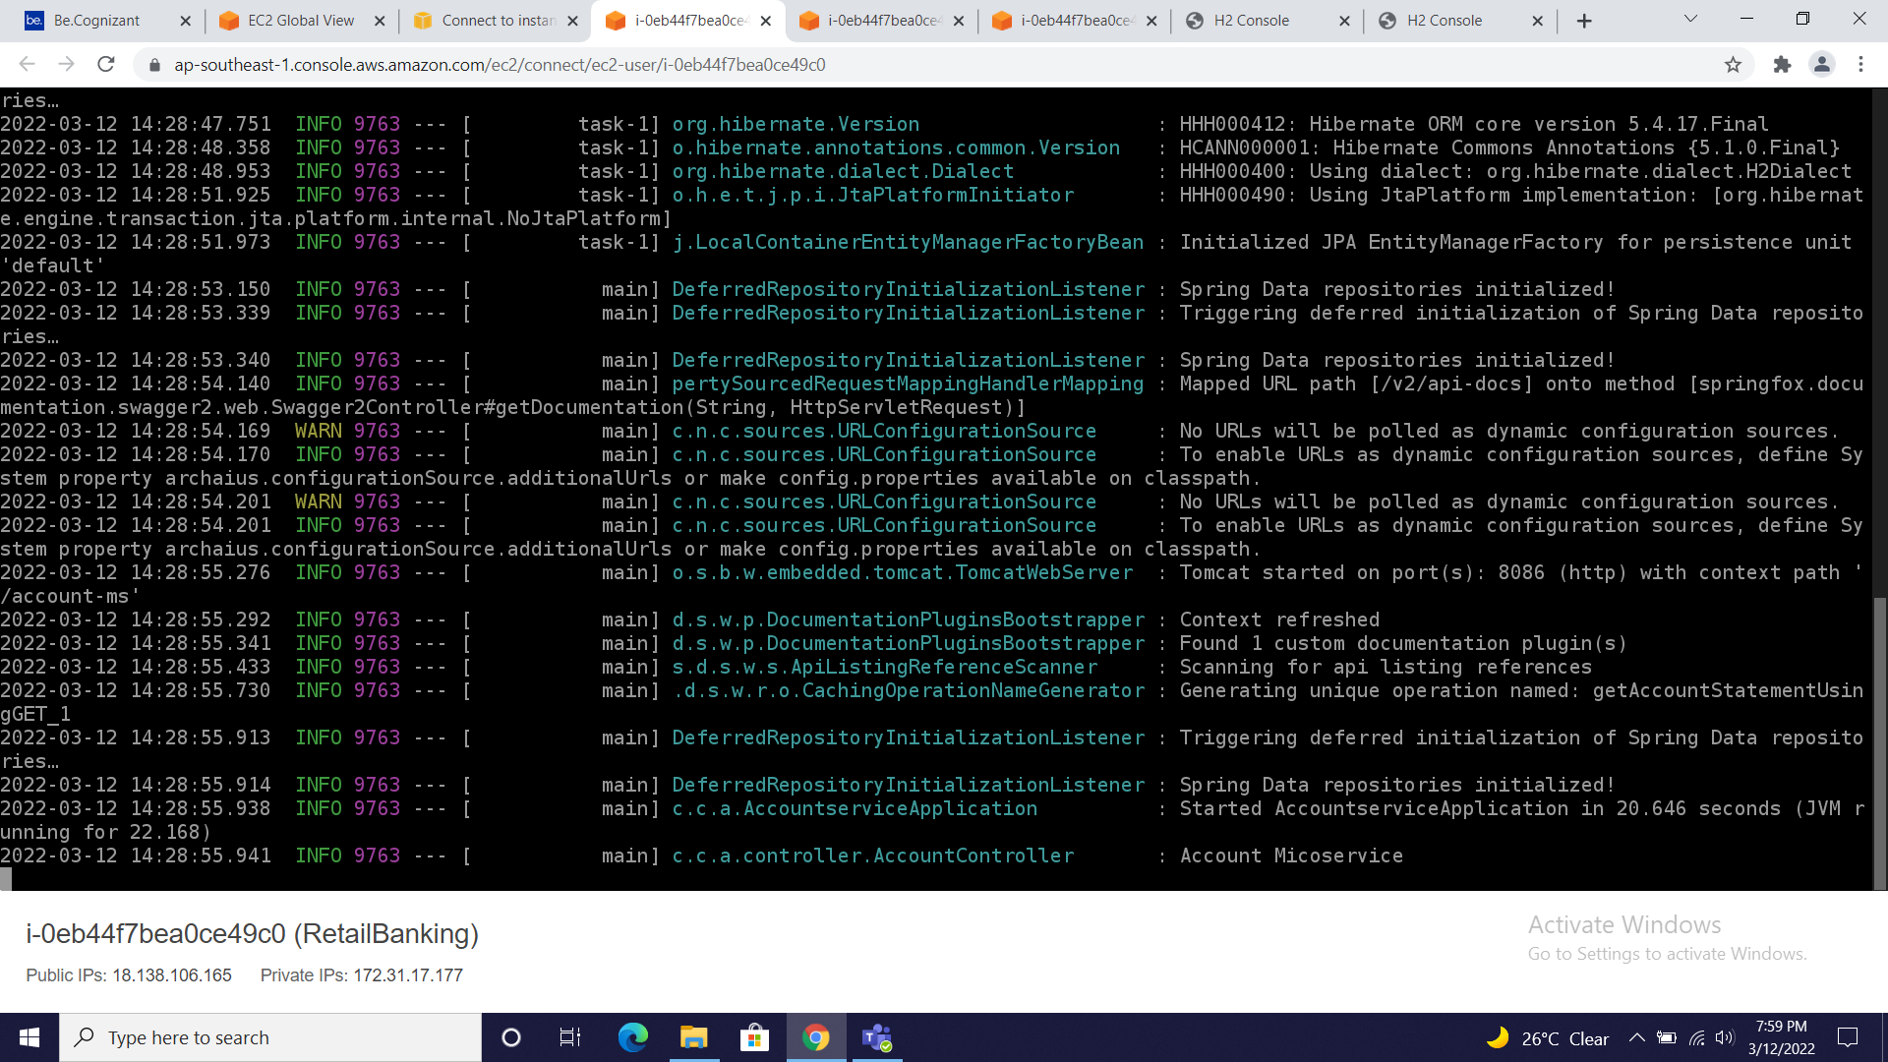
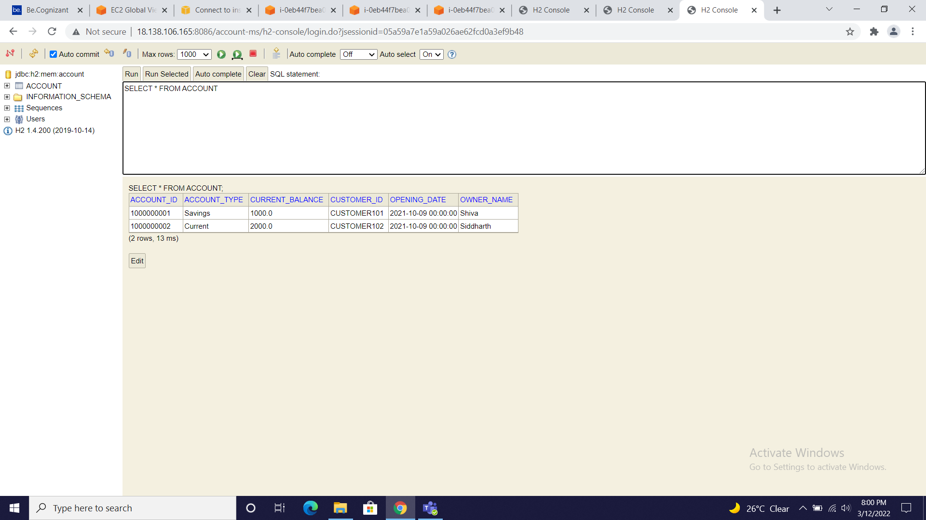

Slide 30
Thank you

